Slide 1
Machine Learning helps me in my Venue hopping Tour Venture
Gurpratap Singh (gpsingh07331@yahoo.com)
Date Published: 25th June 2019

Slide 2
Problem Statement & Concept
Now imagine you are one of those tourists and you want to spend your time in NYC wisely. With size of NYC and so many choices available and gems of them hidden around and you want to cover the best of everything, how would you do it. How can you optimize your day so that you can experience the best of everything?
Here I offer you an optimized tour so you can spend your time wisely and get the best experience of whole of NYC in least amount of time.
Well at least let me start small and give you best of Eating, departmental shop and electronics experience across NYC in smallest possible time and allow you to select the section of NYC as a choice.

Slide 3
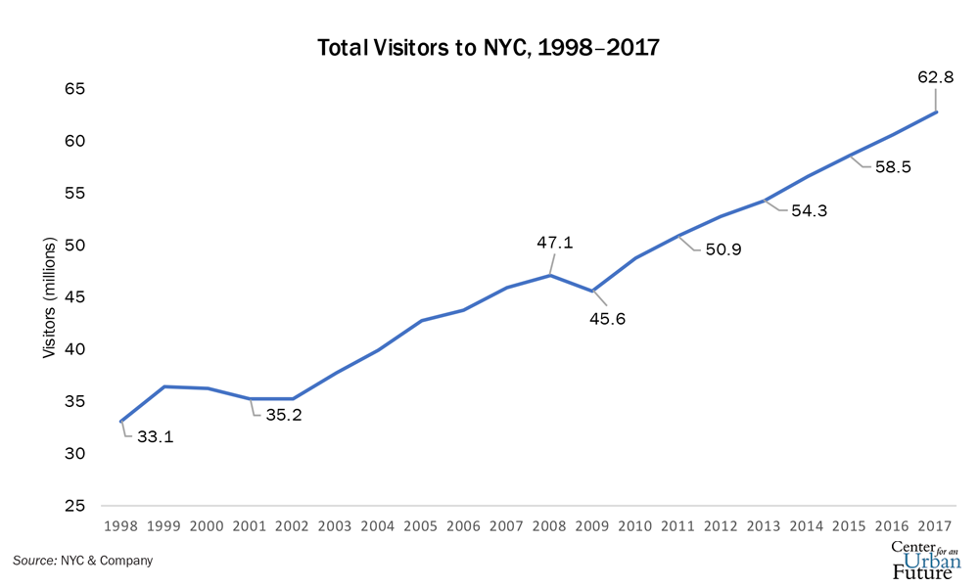
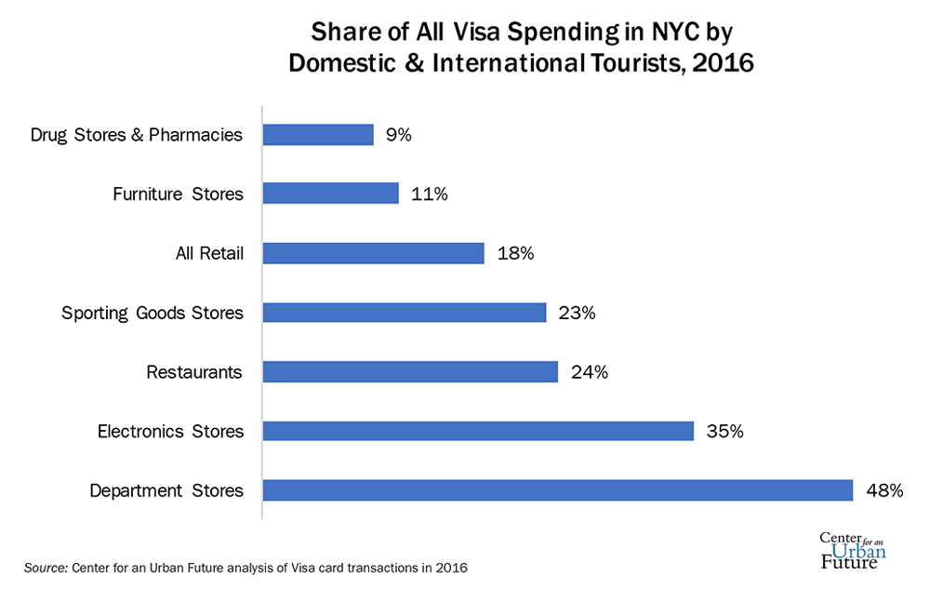
Stakeholders & Supporting data
I, as the owner of Travel related online business.
Tourists who have come to get relief from daily stress.

Slide 4
Questions I need answer for so as to provide the above experience.
How can divide the NYC into sections so as to get the location data for each of these sections?
Where can I find the trusted data source for the best rated and liked Eating, Departmental and electronics shop location in NYC.
How can I optimize the time taken to visit each of the top venue categories in each section of NYC?
Which section should I visit first or should be the only section to visit?

Slide 5
Problem to Outcome flow
Getting Value from data
Outcome
Data Gathering
Approach
Modeling

Slide 6
Data Gathering
New York City data that contains list Boroughs, Neighborhoods along with their latitude and longitude.
Data source: https://geo.nyu.edu/catalog/nyu_2451_34572
Description: This data set contains the required information. And we will use this data set to explore various neighborhoods of New York city.
Venues in each neighborhood of New York city with category, ratings and likes.
Data source: Fousquare API
From the categories available,
https://developer.foursquare.com/docs/resources/categories
I will be looking for Food, Electronics Store and Department Store only.
To get Listing of venues in NYC
https://developer.foursquare.com/docs/api/venues/search
To get ratings and likes for the venues.
https://developer.foursquare.com/docs/api/venues/details
GeoSpace data
Data source: https://data.cityofnewyork.us/City-Government/Borough-Boundaries/tqmj-j8zm
Or Use geopy library to get the latitude and longitude values of New York City
Route Time Travel Data
Data source: https://docs.microsoft.com/en-us/bingmaps/rest-services/routes/calculate-a-route
Or https://github.com/Project-OSRM/osrm-backend/blob/master/docs/http.md#responses

Slide 7
Approach
Question/Hypothesis
Divide NYC into sections with each of the desired category, viz., Department Store, Electronics Store and an Indian Restaurant.
If we get at least 3 sections within NYC then I can offer choices to the tourists to include the hopping tour in their iternary. In future I can expand to give them to choose the venue choices.
EDA – Collect Information, revise expectation or collect more data.
Formal Modeling – Primal model answers question.
Interpretation of analysis provides a specific & meaningful answer to the hypothesis.

Slide 8
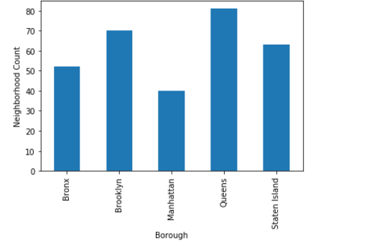
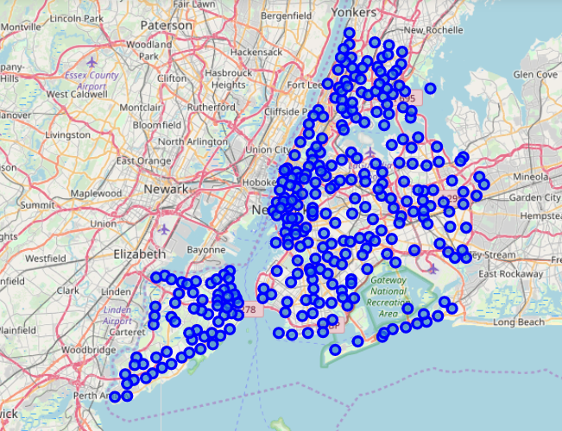
EDA
Let’s see how are the neighborhoods spread out in NYC

Slide 9
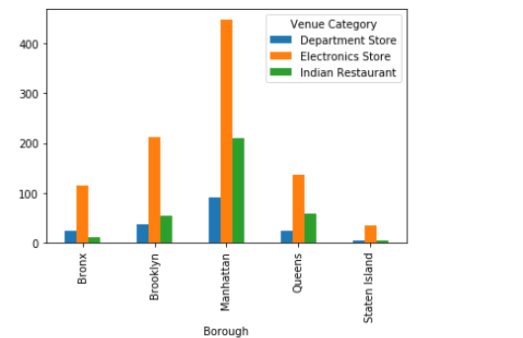
EDA
Let’s see how are the interested venues spread out in NYC.
So, we have unbalanced distribution but good enough to create our section of NYC to create clusters.

Slide 10
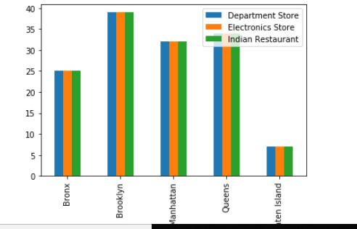
EDA
Let’s see how are the interested venues spread out in NYC. Data is obtained using Foursquare explore API.
So, we have unbalanced distribution but good enough to create our section of NYC to create clusters.
We are only interested in venues with ratings > 5 and likes > 50. Right side fig displays that data.

Slide 11
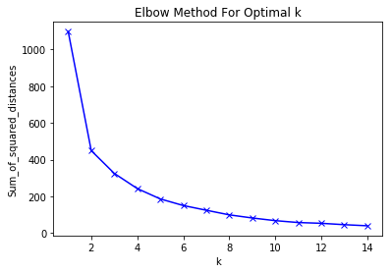
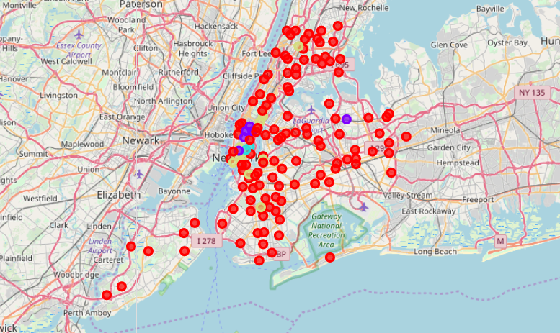
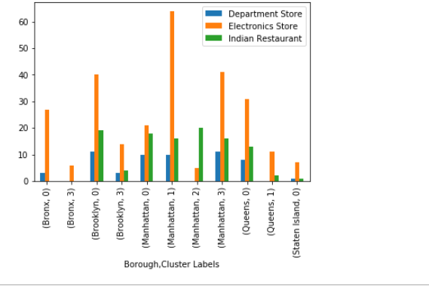
Modeling
We will use unsupervised clustering, KMeans. We will use Elbow method to figure out the optimal k.
We use Folium to visualize the cluster distribution. We observe that cluster 0 has the biggest spread.

Slide 12
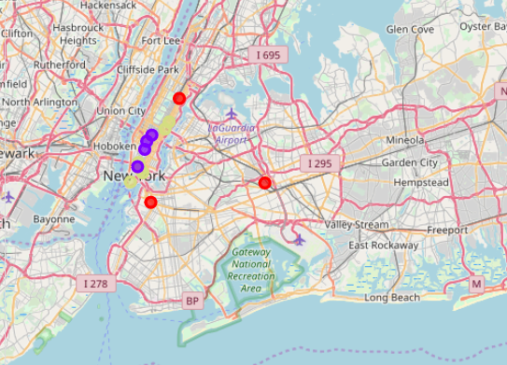
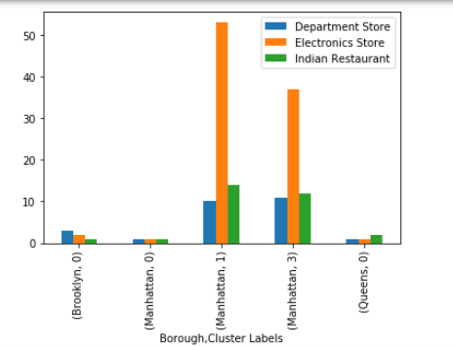
Modeling
Clusters having at least one of each venue category. We have good enough cluster spread to validate our concept of offering tourist venue hops spread across NYC.

Slide 13
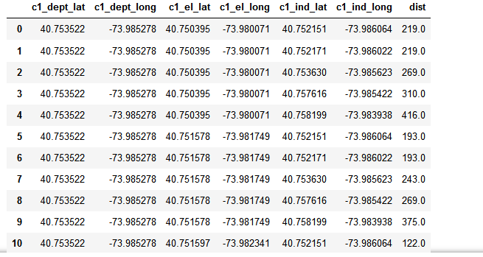
Modeling
Now we will use Bing API to get the best time trave option for each cluster.
http://dev.virtualearth.net/REST/v1/Routes?wayPoint.1={wayPpoint1}&viaWaypoint.2={viaWaypoint2}&waypoint.3={waypoint3}&wayPoint.n={waypointN}&heading={heading}&optimize={optimize}&avoid={avoid}&distanceBeforeFirstTurn={distanceBeforeFirstTurn}&routeAttributes={routeAttributes}&timeType={timeType}&dateTime={dateTime}&maxSolutions={maxSolutions}&tolerances={tolerances}&distanceUnit={distanceUnit}&key={BingMapsKey}
Sample output

Slide 14
Outcome
My hypothesis that I can use NYC data, Foursquare API and Bing API for a Virtual tour is correct. NYC itself has a potential for multiple tour locations. I can use similar method ofr other cities. This will value add to my Travel website. But I need to add more Venue categories. I also need to add Hotel location. I can also use the above clustering and distance optimization technique to make it interactive with the user.
II may also try DBSCAN algorithm to form non circular clusters.

